Slide 1

Acorn Squash with brown rice & turkey sausage: EW IV
Ingredients
Instructions
Lightly grease microwave-safe large plate; place squash halves, cut side down. Cook squash in microwave on high 8-9 minutes or until fork-tender; set aside to cool enough to handle.
Preheat oven to 375 degrees F. Line a 15 ½ by 10 ½ jelly roll pan with foil. In a non-stick 12 “ skillet, heat oil over medium heat until hot. Add sausage and cook until browned; breaking up the sausage with the side of a spoon. With a slotted spoon, transfer sausage to a large bowl.
To the same skillet, add onion, red pepper, & ¼ tsp pepper & cook over medium heat for 6-8 minutes or until browned; add to sausage bowl.
With spoon scoop out the squash & add to the bowl of sausage, leaving ¼ “ thick shell. Stir in rice & parsley until combined.
Spoon sausage mixture into squash shells; place in prepared pan. Bake 20 min. until heated thru.
2 acorn squash (about 2 ½ #)
1 Tbsp. olive oil
½ # sweet Italian turkey or chicken sausage
1 small onion, diced
1 red pepper, diced
Black pepper
1 pkg. (2 c.) precooked whole grain brown rice
2 Tbsp. chopped fresh parsley leaves
Serving Size: ½ squash, 4 servings

Slide 2
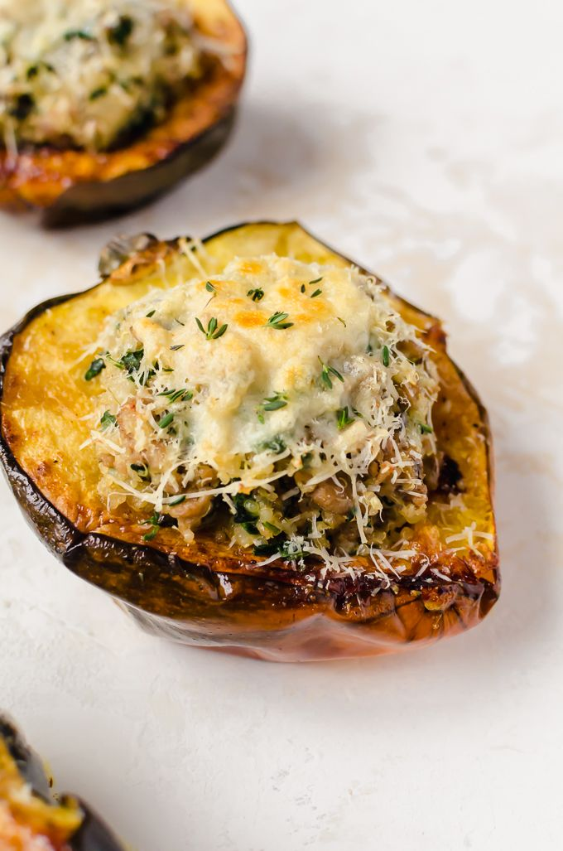
Acorn Squash with brown rice & turkey sausage
Nutrition Tip
Serve these with a green side salad or small bowl of vegetable soup for some added color and nutrition!

