Slide 1
Winter Squash & Spinach Lasagna – EW III
Ingredients
1 (10 oz) cottage cheese
1 (10 oz) pkg. frozen leaf spinach, thawed & squeezed of excess moisture
¾ cup part-skim mozzarella, coarsely grated
4 Tbsp. grated pecorino cheese
1/8 tsp. Nutmeg
1 Butternut squash , cooked & pureed (or use 10 oz. pkg frozen squash, puree, thawed)
8 no-boil lasagna noodles
½ c. plain yogurt
Pepper to taste
Instructions
Heat oven to 425 degrees F. In a food processor, puree the cottage cheese & spinach until smooth. Transfer to a bowl & fold in ½ c. mozzarella, 2 Tbsp. pecorino, nutmeg & ¼ tsp. pepper.
Spread ½ c. squash on the bottom of an 8” square baking dish. Top with 2 noodles & spread ¼ cup of the remaining squash over the top. Dollop ¾ c. of the cottage cheese mixture; repeat twice.
Place remaining 2 noodles on top. Spread the yogurt over the top of the noodles. Sprinkle with mozzarella (1/4 c.) & 2 Tbsp. pecorino cheese. Cover tightly with an oiled foil & bake 15 min. Uncover & bake until noodles are tender & top is brown. 8-10 minutes. Broil 2 minutes.
Serving Size: 1 cup, 4 servings

Slide 2
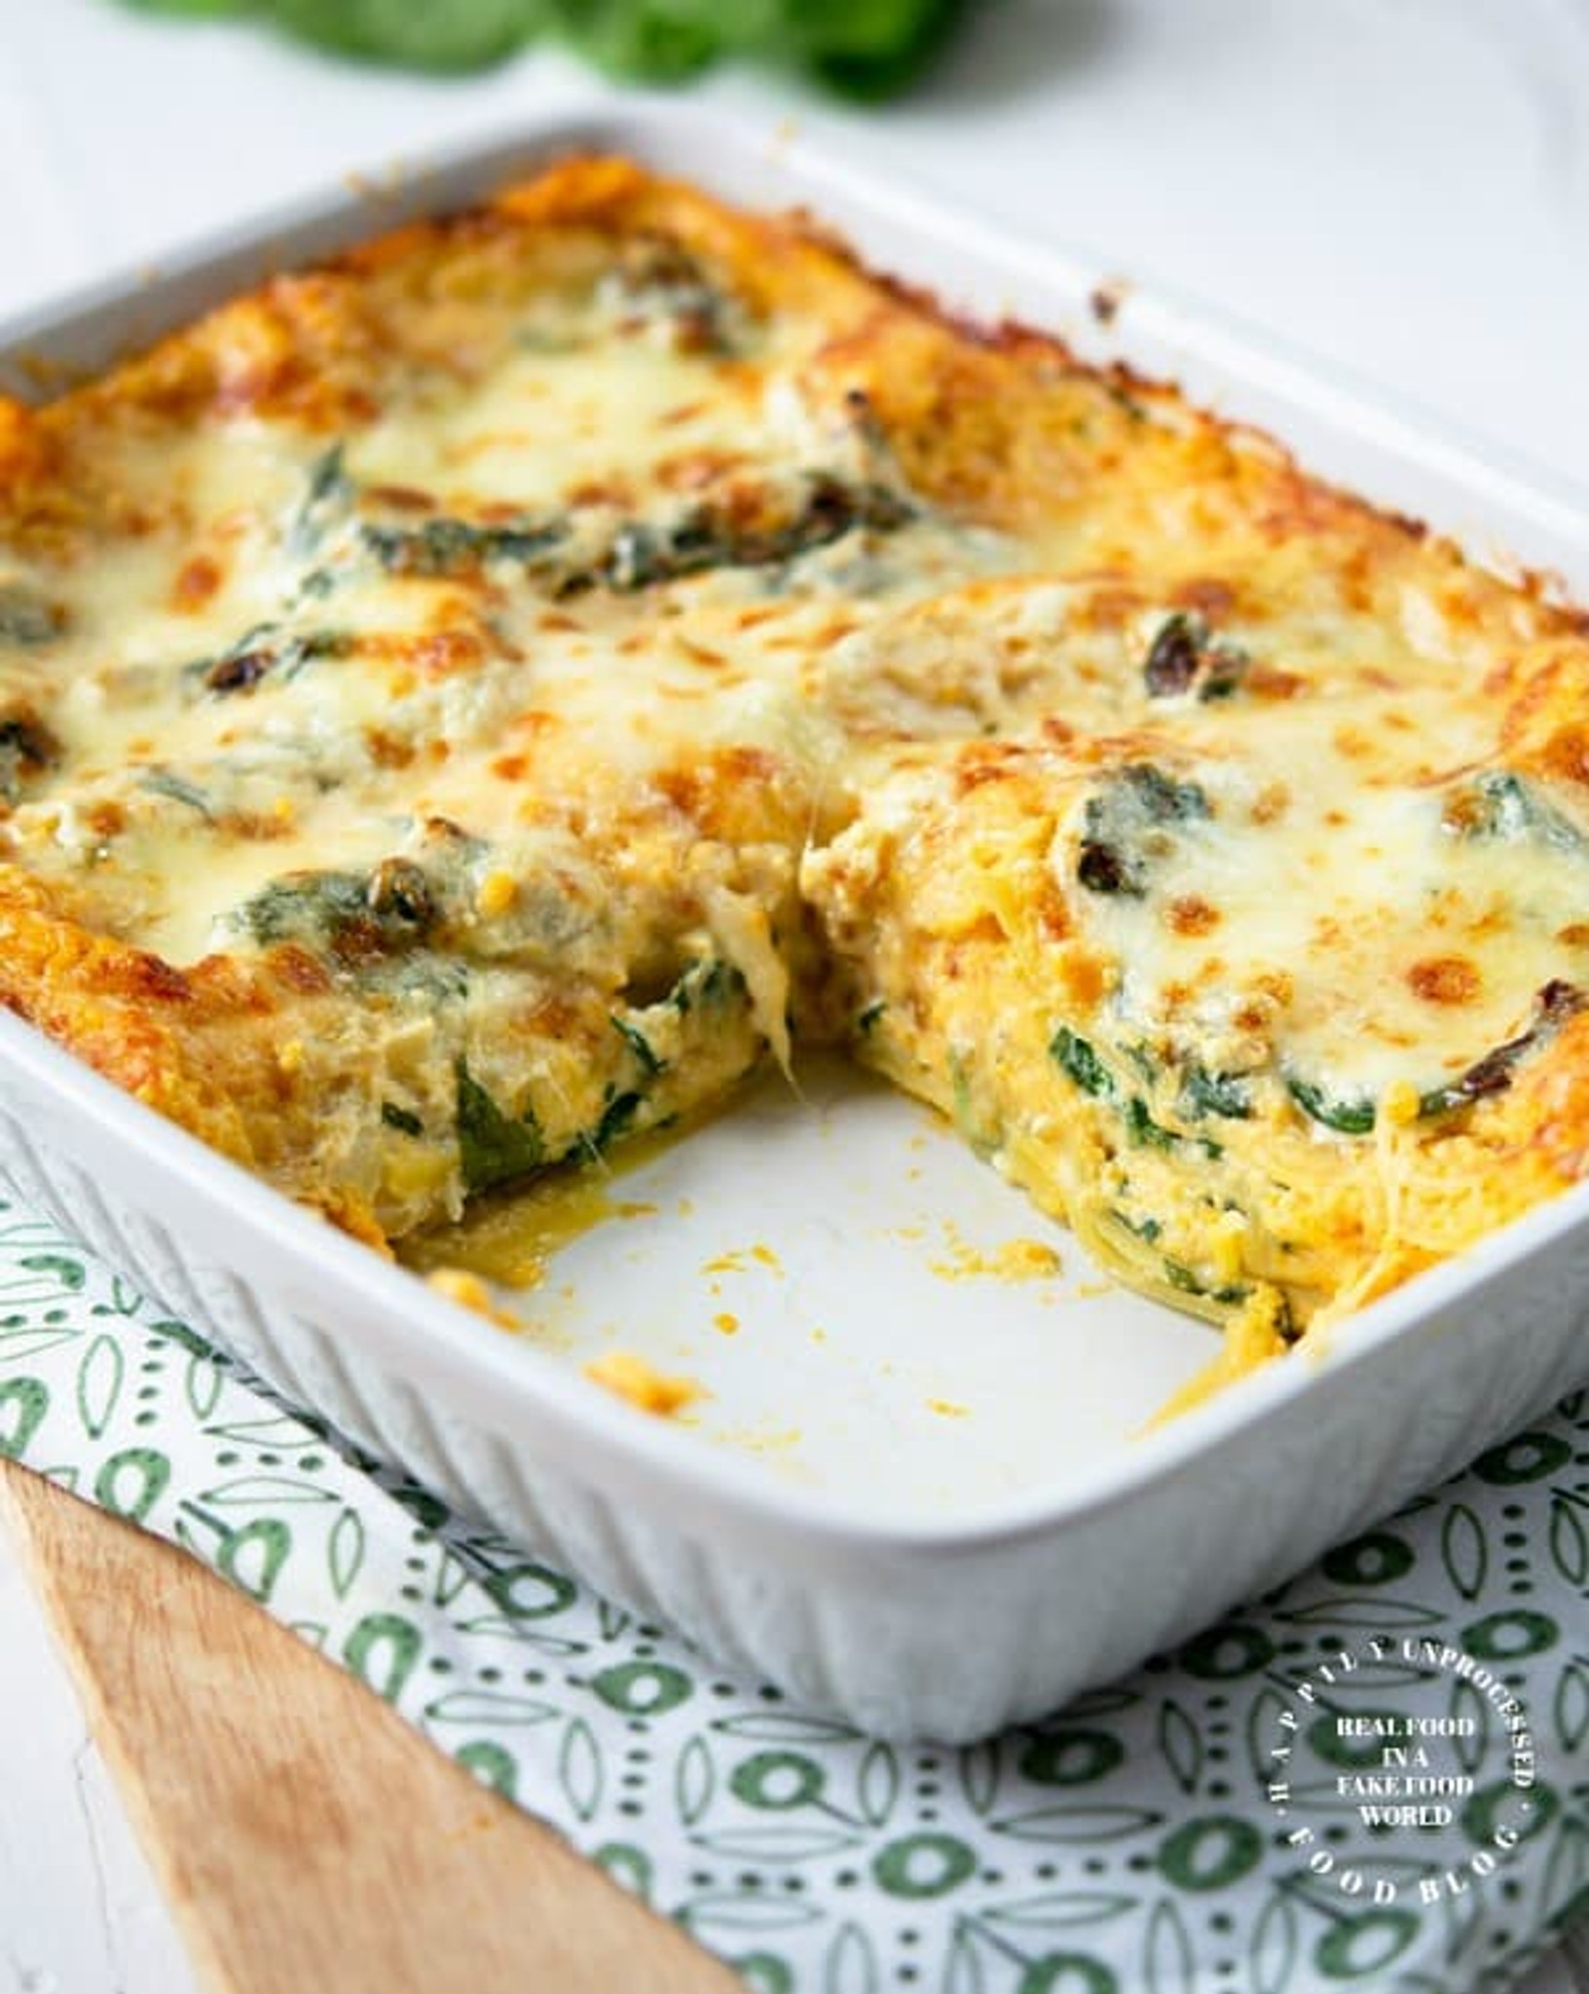
Winter Squash & Spinach Lasagna
Nutrition Tip
Squash and spinach are both anti-inflammatory foods that are full of antioxidants and fiber! 1 cup of squash contains 9% of your daily vitamin A needs (good for eyesight!)

