Slide 1
Moroccan Butternut Squash & White Bean Soup: BW II
Ingredients
1 large butternut squash
2 Tbsp. olive oil
1 onion, chopped
2 cloves garlic, finely chopped
1 (1”piece) fresh ginger, finely chopped
6 c. low sodium chicken broth
6 sprigs fresh thyme
1 (15 oz) can white beans, rinsed
1 (15 oz) can chickpeas, rinsed
½ c. couscous
¼ c. roasted pistachios, finely chopped
¼ c. dried apricots, finely chopped
¼ c. fresh cilantro, chopped
1 scallion, sliced
Instructions
Cut neck off butternut squash. Peel & cut into ½” pieces. Heat 1 Tbsp. olive oil in nonstick skillet on medium. Add the squash & cook, covered, stirring occasionally, 8 minutes.
Heat remaining oil in Dutch oven on medium. Add onion & cook, covered, stirring occasionally, 6 minutes. Stir in garlic & ginger & cook 1 minute.
Add broth, thyme & butternut squash & bring to a boil. Using a fork, mash white beans & add to soup along with the chickpeas.
Cook couscous as label directs, fluff with a fork & fold in pistachios, apricots, cilantro & scallion. Serve soup topped with couscous mixture.
Serving Size: 1 cup, 4 servings

Slide 2
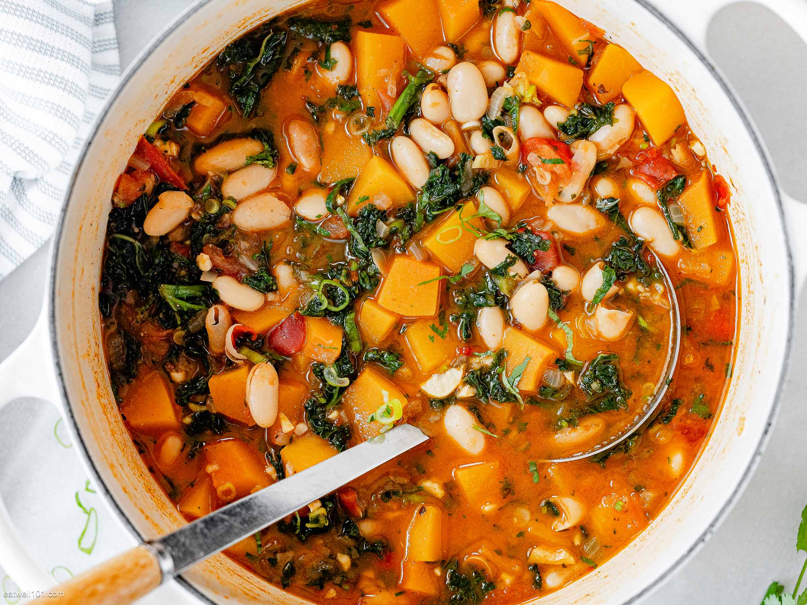
Butternut Squash & White Bean Soup
Nutrition Tip
Check to make sure your meal has all the macronutrients – complex carbs, lean proteins and healthy fats – along with some vegetables or fruits for fiber! Eating balanced meals like this soup can help keep you full/satisfied so you may be less tempted to snack on unhealthy foods throughout the day.

