Slide 1
Roasted Chickpea, Tomato & Chicken Bowls: BW I
Ingredients
Instructions
Heat oven to 425 degrees F. With mortar & pestle, coarsely grind coriander & cumin seeds. Stir in red pepper flakes.
On rimmed baking sheet, toss tomatoes & garlic with 1 Tbsp. oil & spices. Roast 12 minutes.
Heat 1 tsp. oil in small skillet on medium. Season chicken with pepper and cook until golden brown, 5-6 minutes. Turn & cook 1 minute.
Toss mixture with chickpeas, nestle chicken among tomatoes & continue roasting until chicken is cooked thru, 6 to 8 minutes more. Transfer chicken to cutting board & let rest 5 minutes, before slicing.
In bowl, toss farro, scallion, vinegar, remaining 1 Tbs. oil, & pinch of pepper. Fold in chickpea-tomato mixture & chicken, then greens.
½ Tbsp. coriander seeds
1 tsp. cumin seeds
¼ tsp. red pepper flakes
Pepper
2 cups grape tomatoes
4 cloves garlic, smashed
2 Tbsp. plus 1 tsp. olive oil
1 (8 oz) skinless chicken breast
1 (5 oz. can) chickpeas, rinsed
1 c. cooked farro
1 scallion, thinly sliced
1 ½ Tbsp. white wine vinegar
4 cups baby greens (spinach, kale, arugula or combo)
Serving Size: 1 cup, 4 servings

Slide 2
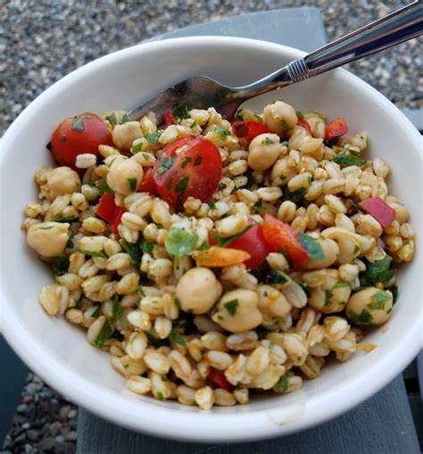
Roasted Chickpea, Tomato & Chicken Bowls
Nutrition Tip
Farro is an ancient whole grain (similar to rice) that has a nutty flavor and chewy texture – just ¼ cup contains 7 grams of fiber and 7 grams of protein to help keep you full! Add to bowls, salads, soups and more!

